Slide 1

IBM Project Presentation
on
“Proactive Equipment Care using Analytics with Cloud - Cloud Integrated Analytics”
By
Group ID: G03
Team Members Name & Enrollment No:
Patel Megh(22162121011)
Prajapati Pratham(22162171023)
Patel Tirth(22162101016)
Under The guidance of
Prof. Umesh Lakhtariya /Mr. Anoj Dixit
Institute Of Computer Technology, Ganpat University
Date:- 11th April 2026

Slide 2
Index Of Content
Abstract
Problem Statement
Objectives
Scope of the Project
Workflow of Project
ML Training Workflow
System Architecture
Technology Stack
Module Description
Advantages
Limitations

Slide 3
Abstract
Proactive Equipment Care using Analytics with Cloud is a cloud-based intelligent maintenance system designed to predict equipment failures before they occur.
Traditional maintenance approaches are reactive, leading to unexpected downtime and high repair costs. This system integrates data analytics, machine learning, and cloud computing to monitor equipment health in real-time.
Motor data is processed and analyzed to detect patterns and anomalies.
The ML model predicts potential failures, enabling preventive maintenance.
The solution improves operational efficiency, reduces downtime, and enhances equipment lifespan.

Slide 4
Problem Statement
Industries rely heavily on reactive maintenance strategies, where equipment is repaired only after failure occurs. This leads to:
The Flaws of Reactive Maintenance: Heavy reliance on traditional maintenance—repairing equipment only after it fails—results in unexpected breakdowns, significant production losses, high repair costs, and increased safety risks.
Operational Bottlenecks Without Analytics: The absence of intelligent analytics makes it extremely difficult for industries to optimize their maintenance planning, efficiently allocate resources, and manage spare parts effectively.
The Need for Proactive Systems: To prevent unexpected failures, industries require a smart system powered by cloud computing and analytics to continuously monitor equipment health and anticipate issues early.
Solution:- There is a need for an intelligent cloud-based system that can predict equipment failures before they happen.

Slide 5
Objectives
Secure Data Collection & Cloud Infrastructure: Develop a secure, cloud-based platform to continuously collect, process, and store vital equipment data (such as temperature, vibration, and load) for remote, real-time health monitoring.
Predictive Analytics & Machine Learning: Apply advanced machine learning algorithms to analyze operational data, extract meaningful insights, and identify early warning signs to predict and prevent unexpected failures.
Real-Time Visualization: Deliver an intuitive, real-time dashboard that visually represents equipment status, predictive alerts, and historical trends to facilitate rapid, data-driven decision-making.
Proactive Maintenance & Cost Reduction: Transition from reactive repairs to a proactive, predictive maintenance strategy, significantly reducing unexpected operational downtime and long-term maintenance costs.

Slide 6
Scope
Our idea will Help in:
Real-Time IoT Monitoring & Data Collection: Integrate smart sensors and industrial IoT devices to continuously track vital operational parameters—such as temperature, vibration, and load—in real time.
Scalable Cloud Architecture & Remote Access: Leverage cloud deployment to efficiently manage increasing data volumes and multiple equipment units, allowing users to monitor systems and access predictions remotely from any location.
Predictive Analytics & Proactive Decision-Making: Utilize data-driven models to analyze equipment patterns, detect early warning signs, and predict failures before they occur, empowering maintenance teams with faster, proactive decision-making.
Cross-Industry Application & Risk Mitigation: Implement the system across manufacturing, power plants, and heavy machinery environments to maintain continuous productivity, support preventive maintenance, and reduce overall operational risks.

Slide 7
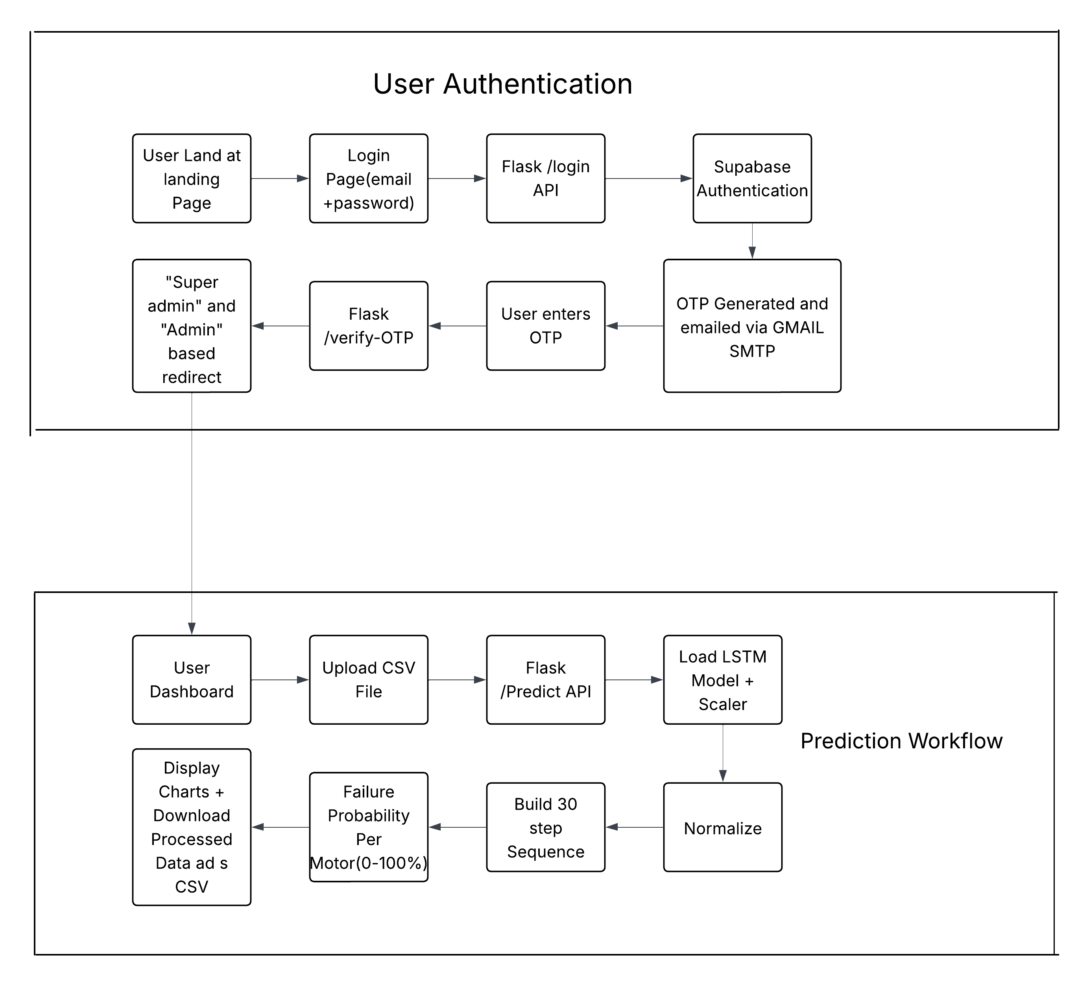
Workflow Of Project

Slide 8
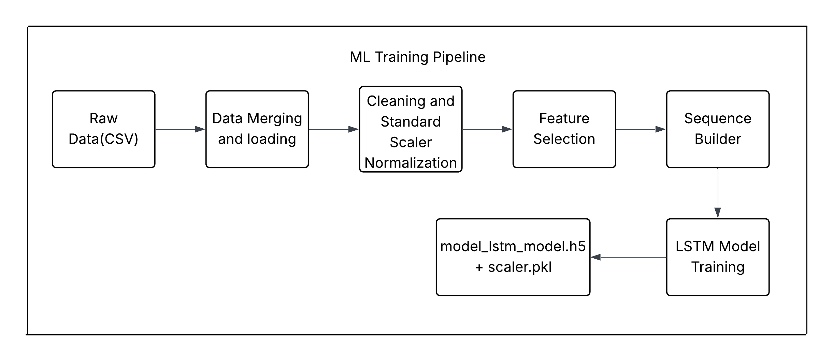
ML Training Workflow

Slide 9
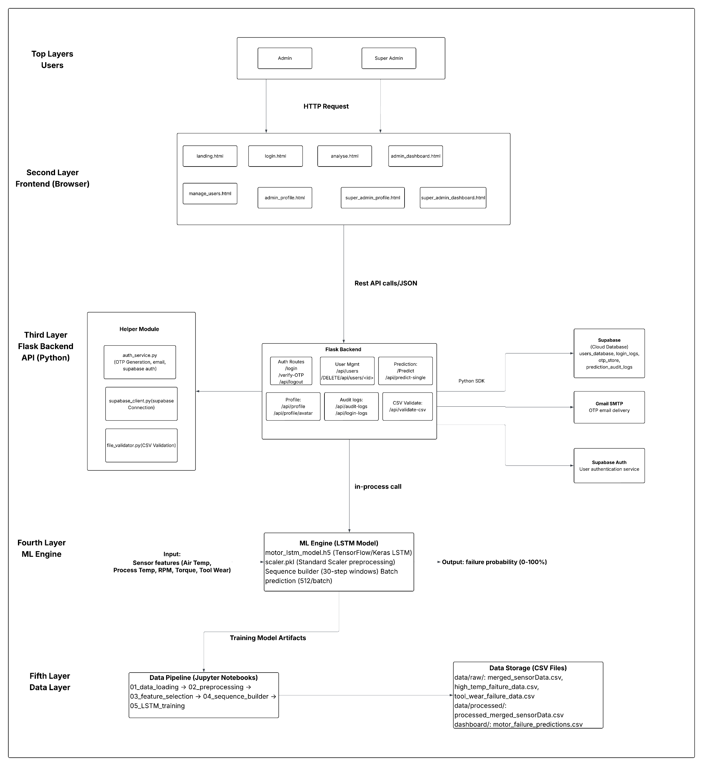
System Architecture

Slide 10
Module Description
Data Generation Module
Collects and manages motor sensor data such as temperature, vibration, current, and load, either from cloud storage or simulated CSV datasets.
Data Processing Module
Cleans, normalizes, and prepares raw sensor data through preprocessing and feature engineering for accurate model training.
Prediction Module
Uses the trained LSTM machine learning model to analyze time-series data and predict equipment failure probability.
Dashboard Module
Displays real-time equipment status, prediction results, and historical trends through an interactive web-based interface.
Authentication Module
Handles secure user login, role-based access control, and logging of user activities using cloud-based authentication services.

Slide 11
Advantages
Proactive Failure Prevention & Asset Longevity: Reduces unexpected breakdowns and significantly increases equipment lifespan by continuously monitoring performance to detect early degradation and predict potential failures in advance.
Cost Optimization & Operational Efficiency: Minimizes maintenance costs and improves overall efficiency by shifting from reactive repairs to planned, condition-based maintenance, optimizing schedules, and reducing production downtime.
Real-Time Monitoring & Agile Decision-Making: Provides real-time visibility into vital equipment health parameters, enabling faster, data-driven decision-making and enhanced operational control.
Scalable & Secure Cloud Infrastructure: Leverages scalable cloud capabilities to efficiently handle increasing data volumes and multiple equipment units, while protecting sensitive operational information through secure data storage, authentication, and controlled access.

Slide 12
Limitations
Data Quality & Model Reliability: The effectiveness and accuracy of the machine learning model heavily depend on the quality of its training data; accurate, balanced historical data is essential to ensure reliable failure predictions.
High Initial Investment: Implementing the system involves significant upfront costs related to configuring cloud infrastructure, system development, and initial model training.
Continuous Connectivity Requirement: The system strictly requires stable, uninterrupted internet connectivity to facilitate continuous cloud access, real-time monitoring, and seamless data synchronization.

Slide 13
Conclusions
The Proactive Equipment Care system presents an intelligent and scalable approach to predictive maintenance by integrating cloud computing, data analytics, and deep learning technologies. By continuously collecting and analyzing equipment data, the system enables early detection of potential failures and supports proactive maintenance planning. The implementation of an LSTM-based model enhances prediction accuracy, allowing industries to receive alerts 24–48 hours before possible breakdowns.
Overall, this project successfully demonstrates how cloud-integrated analytics can transform traditional reactive maintenance into a data-driven, predictive maintenance strategy. By reducing downtime, lowering maintenance costs, and improving equipment reliability, the system contributes to increased productivity, operational efficiency, and long-term industrial sustainability.

Slide 14
Thank You

